Slide 1
RANI M.
821721104046
BE COMPUTER SCIENCE AND ENGINEERING
SIR ISSAC NEWTON COLLEGE OF ENGINEERING
AND TECHNOLOGY

Slide 2

RAIN PREDICTION(ANN)

Slide 3


AGENDA
The agenda of rain prediction typically involve using various meteorological
data and Models to forecast the likelihood, intensity, and timing of rainfall in
a particular area.
1. Data Collection : Gather meteorological data.
2. Feature Selection : Identify relevant features.
3. Model Selection : Pick suitable algorithm.
4. Training : Train the selected model on the data.
5. Evaluation : Evaluate the model performance.
6. Prediction : Apply the trained model.
7. Validation : Validate on new data.
8. Deployment : Integrate into practice.
9. Monitoring : Monitor the model’s performance over time.
3/21/2024 Annual Review

Slide 4

PROBLEM STATEMENT
.
Despite advancements in Artificial Neural Networks (ANN), accurately predicting rainfall remains a complex and challenging task. ANN-based rain prediction models often struggle with issues such as overfitting, limited generalization to diverse weather conditions, and difficulty in capturing the intricate spatial and temporal patterns of rainfall.
Therefore, there is a need to develop innovative techniques that enhance the performance and reliability of ANN-based rain prediction systems. This includes exploring novel network architectures, incorporating additional environmental variables, optimizing hyperparameters, and integrating real-time data sources to improve forecasting accuracy and resilience in the face of evolving weather patterns. Addressing these challenges will facilitate the development of more robust and adaptive ANN models, providing stakeholders with timely and actionable insights to mitigate risks and enhance preparedness for rain-related events.

Slide 5

PROJECT OVERVIEW
Title: Rain Prediction System
Objective: The aim of this project is to develop a predictive model using artificial neural networks to forecast rainfall. This can have various applications in agriculture, disaster management, and urban planning.
The objective of rain prediction using Artificial Neural Networks (ANN) is to develop a model that can accurately forecast rainfall based on historical weather data and other relevant variables. By training an ANN with past weather patterns and associated rainfall, the model can learn to recognize patterns and make predictions about future rainfall events. This can be valuable for various applications such as agriculture, water resource management, and disaster preparedness.

Slide 6
WHO ARE THE END USERS?
The end users in rain prediction using artificial neural networks (ANN) could include various stakeholders such as farmers, city planners, disaster management authorities, and even individuals planning outdoor activities. These end users rely on accurate rain predictions to make informed decisions regarding agricultural practices, urban infrastructure management, emergency preparedness, and personal plans.
In rain prediction using artificial neural networks (ANN), the end users could be various entities depending on the application. They could use rain prediction to plan their agricultural activities, such as planting and harvesting crops. And the predictions is used to plan for water storage, distribution, and flood management.The Urban planners used to design infrastructure and drainage systems that can handle varying precipitation levels. Individuals may use rain predictions to plan outdoor activities, travel, or simply to know whether to carry an umbrella.

Slide 7

YOUR SOLUTION AND ITS VALUE PROPOSITION
Solution: Rain prediction involves using various methods, such as statistical models, machine learning algorithms, or numerical weather prediction models, to forecast the likelihood and intensity of rain in a specific location over a certain period.
Value Proposition: The value proposition of rain prediction lies in its ability to provide critical information for a variety of sectors and activities. By accurately forecasting rain, businesses, farmers, and individuals can make informed decisions to mitigate risks and optimize operations.
For agriculture, rain prediction helps farmers plan irrigation, planting, and harvesting schedules, maximizing crop yields and reducing water usage. In transportation, it allows for better planning of routes and schedules to avoid disruptions caused by rain-related hazards like floods and accidents.

Slide 8

THE WOW IN YOUR SOLUTION
Predicting rain, the "wow" factor often comes from the accuracy and reliability of the prediction. Advanced algorithms and models, such as machine learning and artificial intelligence, can analyze vast amounts of data to make highly accurate forecasts, sometimes even with lead times of several days. Additionally, innovative approaches, like integrating satellite imagery, weather station data, and historical patterns, can further enhance prediction capabilities, leading to more precise and timely warnings of impending rain events.
.
Our solution’s wow for rain prediction often involves the use of cutting-edge technology like advanced machine learning algorithms and artificial intelligence, combined with a comprehensive data analysis approach that incorporates various sources such as satellite imagery, weather station data, and historical patterns.
.
3/21/2024 Annual Review

Slide 9
MODELLING
Modeling rain prediction involves using statistical or machine learning techniques to forecast the occurrence, intensity, and duration of rainfall. It typically includes analyzing various meteorological data such as temperature, humidity, wind speed, and atmospheric pressure.
Machine learning algorithms, such as regression, decision trees, random forests, and neural networks, are commonly used for rain prediction modeling. These models are trained on historical weather data and may also incorporate real-time data from weather stations or satellite imagery to improve accuracy. Evaluating the performance of these models involves metrics like accuracy, precision, recall, and F1-score. Continuous refinement and validation of models are essential for reliable rain prediction.
.

Slide 10
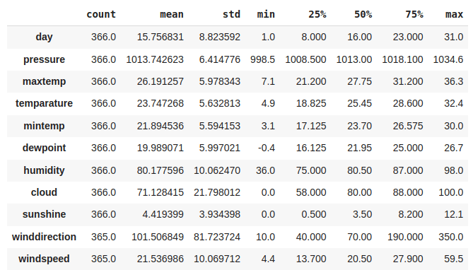
RESULTS
RAIN PREDICTION USING ANN
n

